Slide 1
GOVT.POLYTECHNIC AMBALA CITY
SUBMITTED BY.: SUBMITTED TO.:
1) CHIRAG KAPOOR (16) PAYAL MAM
2) LAKSHAY DHIMAN (33)
3) NITIKA DHIMAN (36)
4) KARAN SHARMA (29)
5) NIKHIL SAINI (35)

Slide 2
PROJECT WORK
Restaurant Management System Project in Python

Slide 3
About Restaurant Management System Project in Python:-
In the Restaurant management system project in Python, we will be having a GUI using which we will be able to do complete billing for any customer. Like we will be able to add items and their price to the bill and also calculate their total price using the total button. Also, the data can be stored in our text file.
The first step in building the project is to define the scope and requirements of the system. This can be done by analyzing the current processes and identifying areas that can be improved. The next step is to design the system architecture and database schema. This involves identifying the entities and relationships involved in the system and creating a data model that can store and manage the data.
After designing the system, the next step is to develop the system components. This involves writing the code for various modules such as user interface, database access, business logic, etc. The code should be modular and well-organized, following best practices for software development.
Once the development is complete, the system should be tested thoroughly to ensure that it meets the requirements and functions as expected. Any bugs or issues should be identified and fixed before deploying the system.
Overall, a Restaurant Management System Project in Python can be a challenging and rewarding project for developers. It requires a good understanding of software development principles and the ability to design and implement complex systems. However, with the right approach and tools, it can be a highly valuable system for restaurant owners to streamline their operations and improve their business performance

Slide 4
IMPORTING MODULES
import smtplib from tkinter import * import random import time from tkinter import filedialog,messagebox

Slide 5
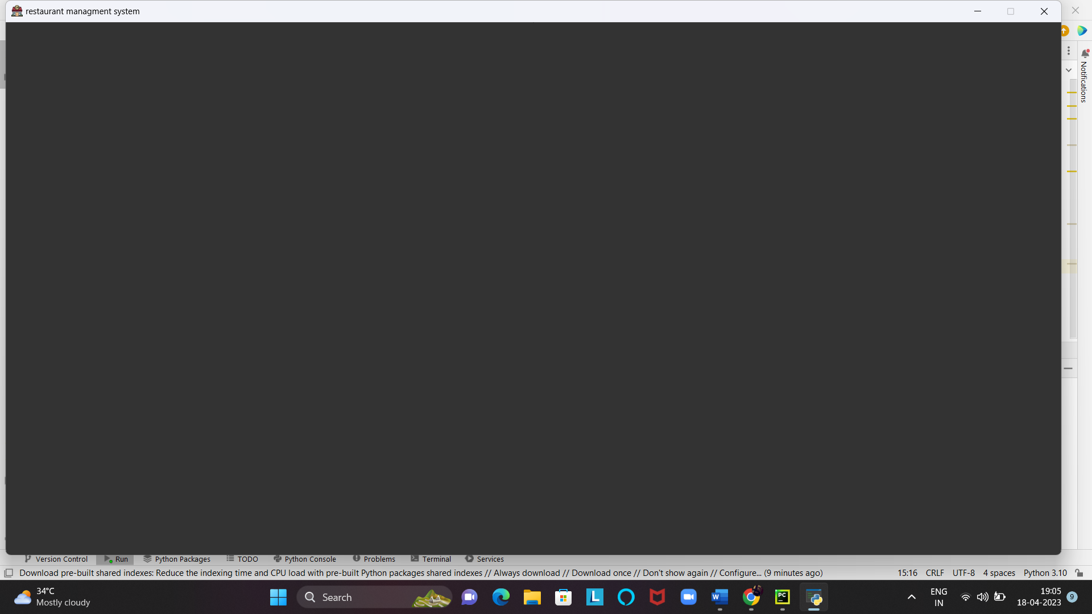
First we create GUI
from tkinter import * import random import time from tkinter import filedialog,messagebox root=Tk() root.geometry('1485x750+0+0') root.resizable(0,0) root.config(bg='grey20') root.title("restaurant managment system") root.iconbitmap('restaurant.ico') topframe=Frame(root,bd=10,relief=RIDGE,bg='grey11') topframe.pack(side=TOP) root.mainloop()

Slide 6
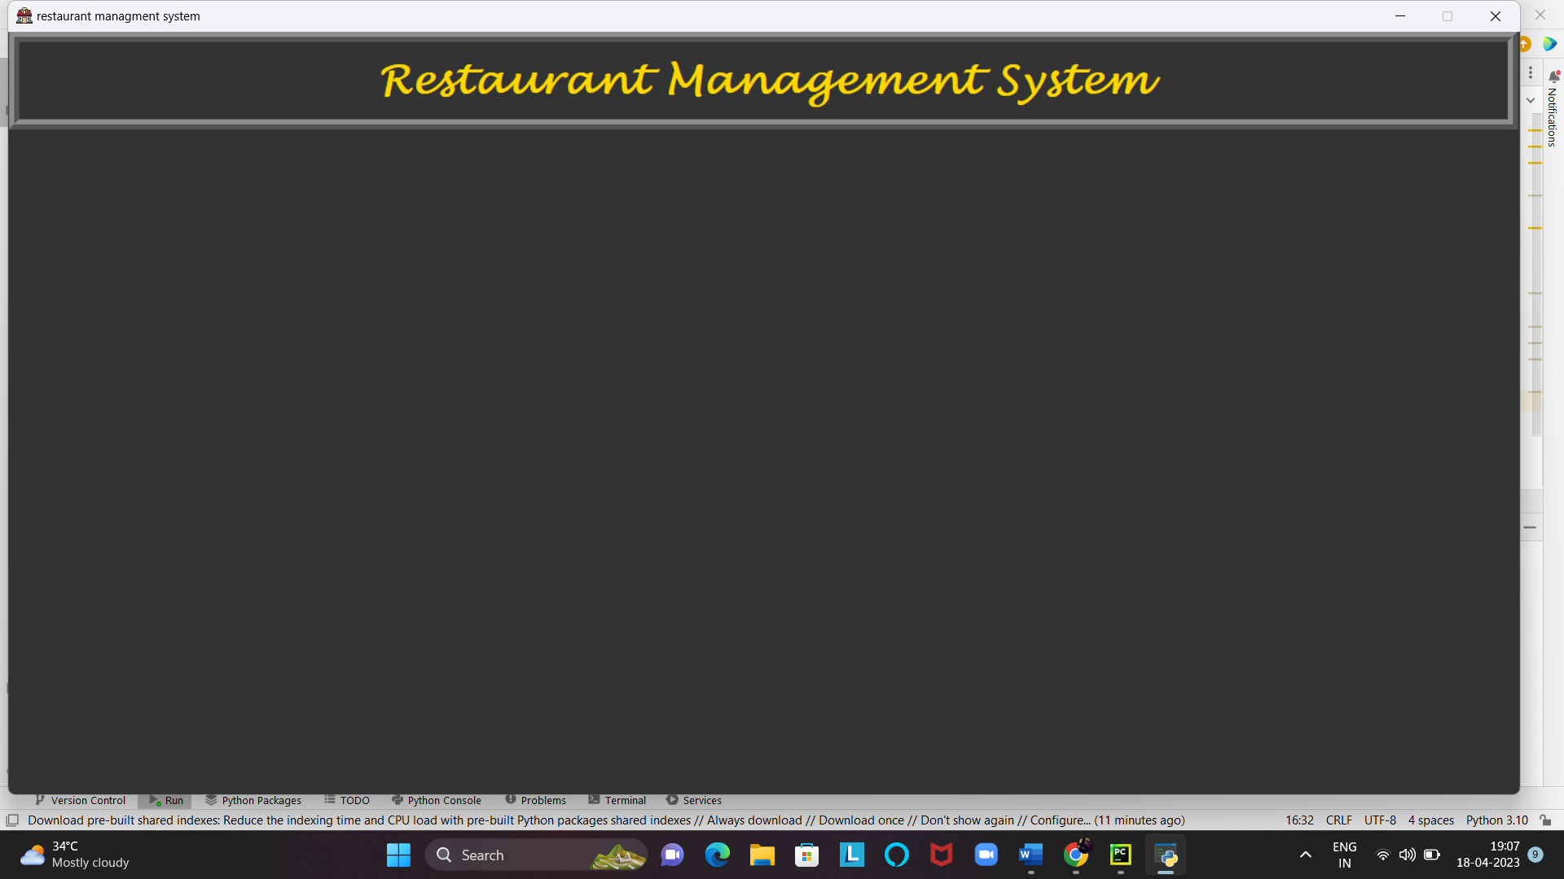
Add restaurant management system label
labeltitle=Label(topframe,text='Restaurant Management System’,
font=('lucida handwriting',30,'bold'),fg='gold', bg='grey20',width=52,pady=10) labeltitle.grid(row=0,column=0)

Slide 7
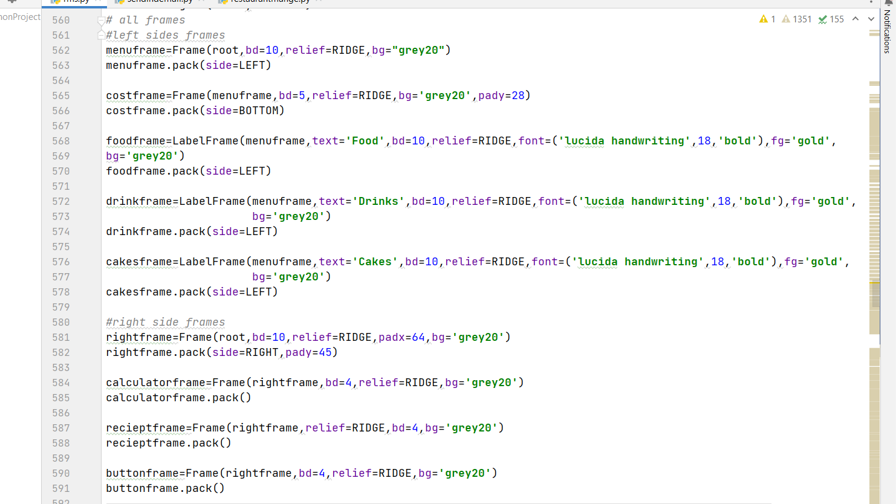
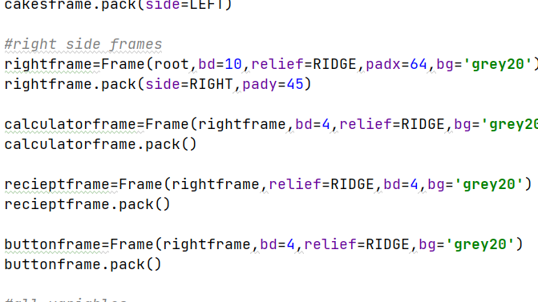
Add all frames

Slide 8
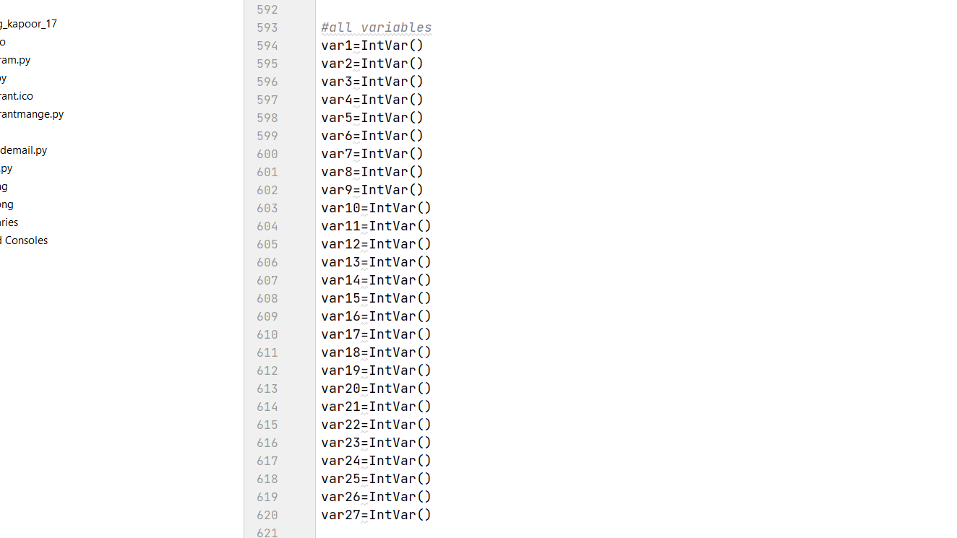
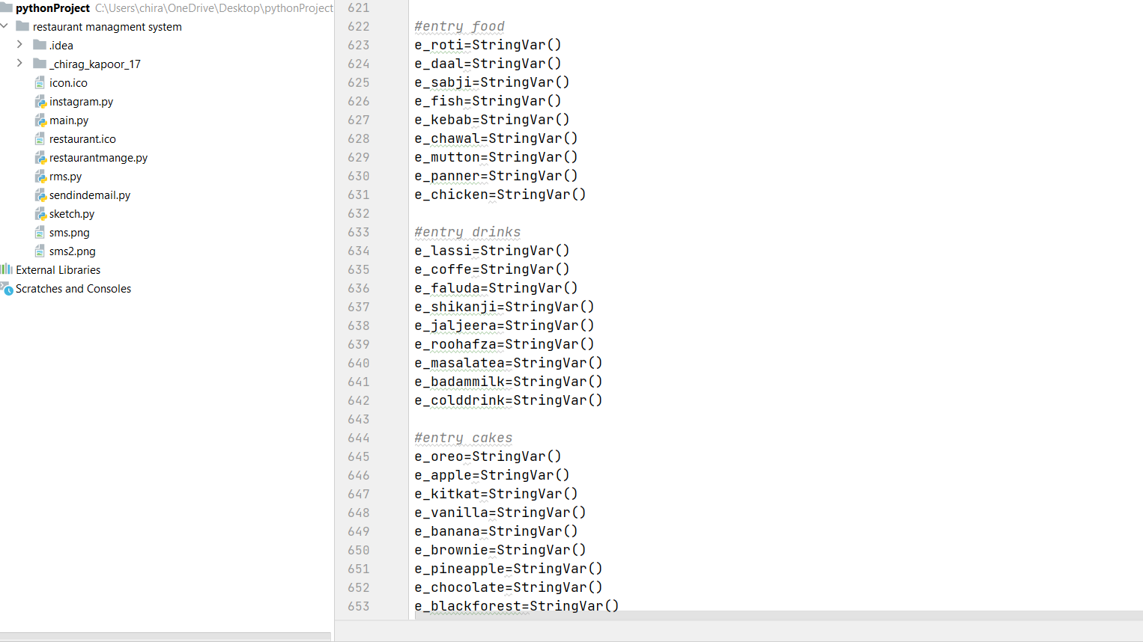
Define all the variables

Slide 9
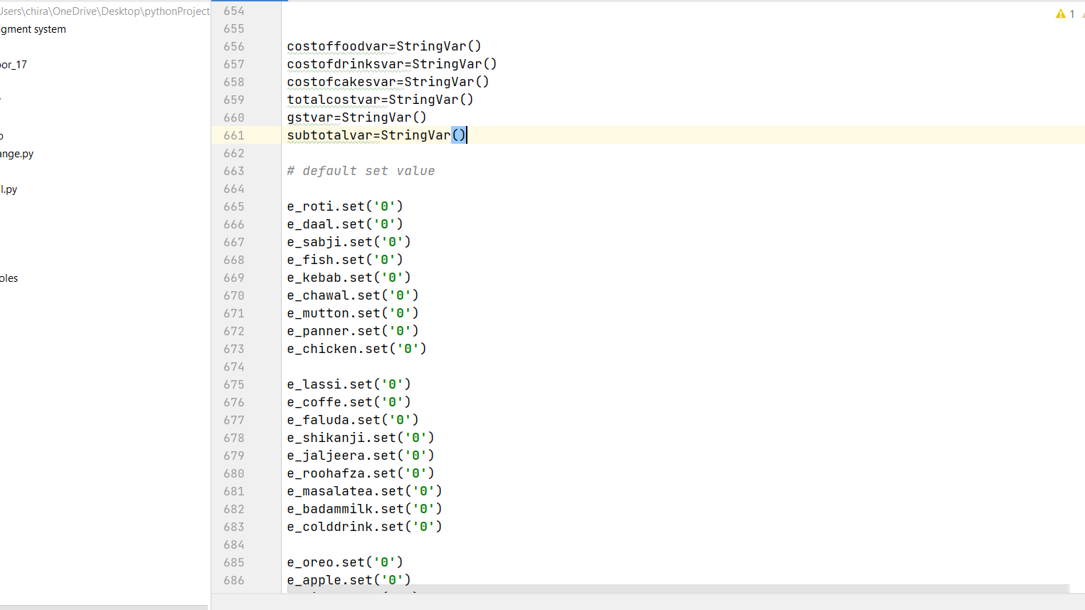
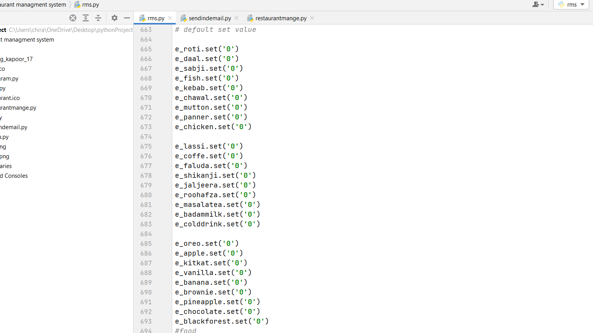
Add default set values

Slide 10
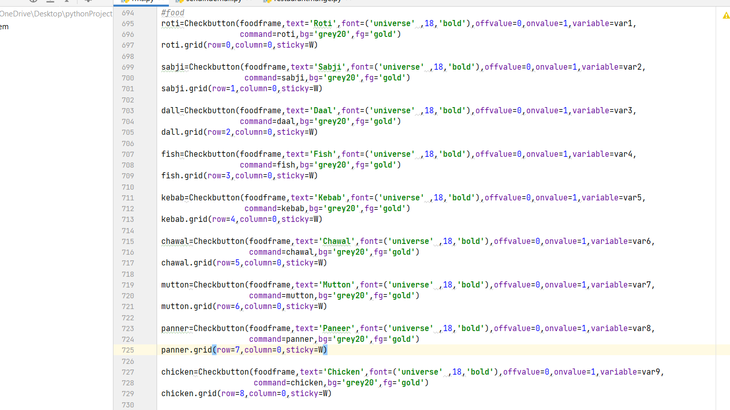
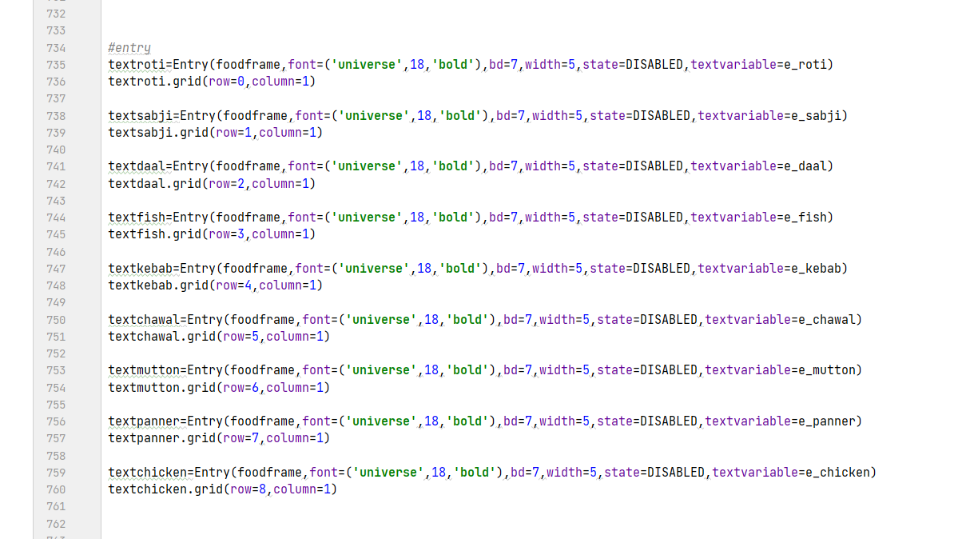
Now we create food frame:-

Slide 11
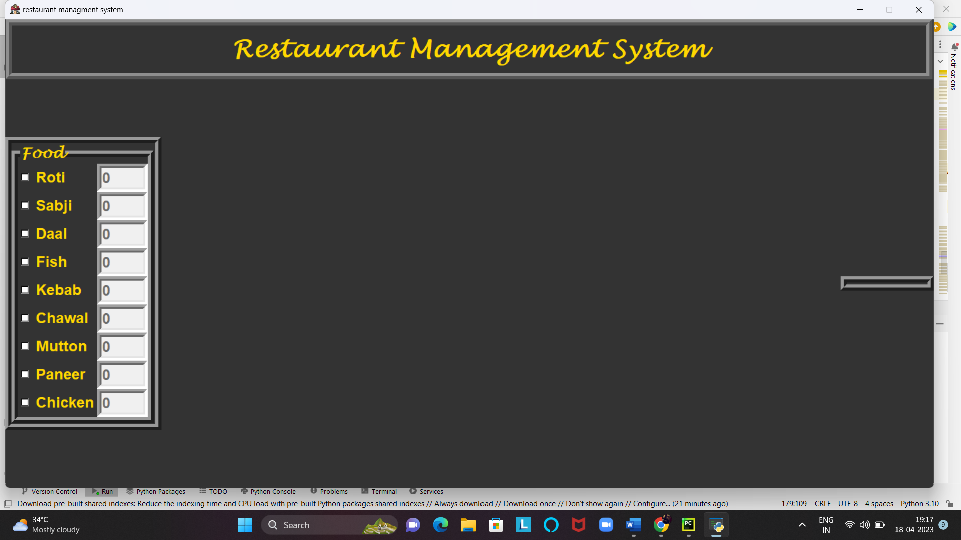

Slide 12
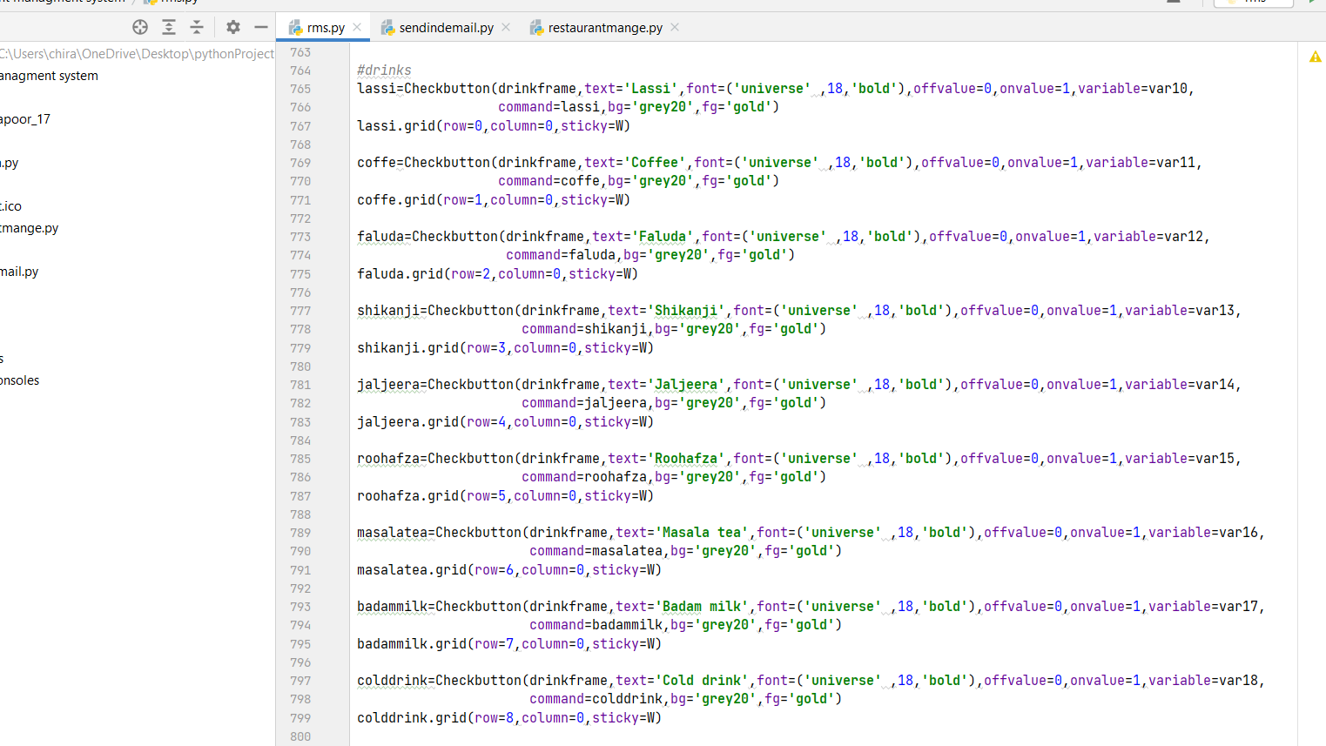
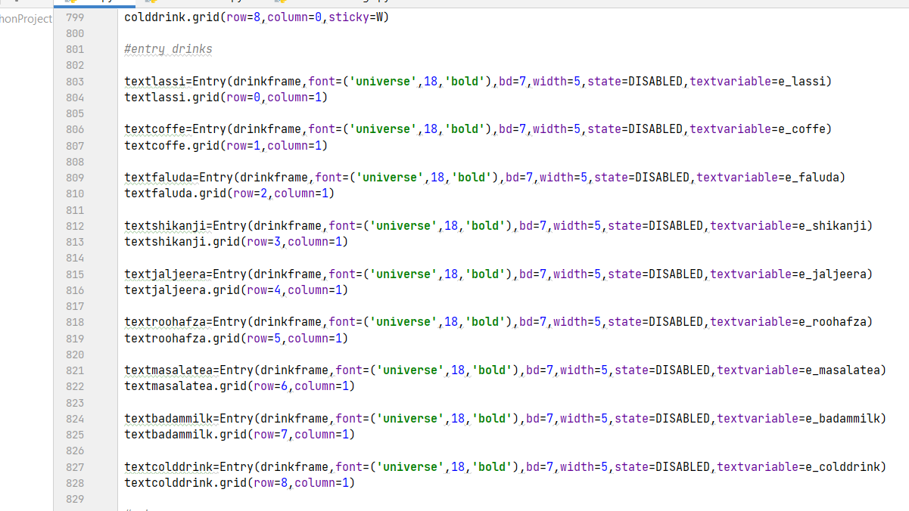
Create drinks frame

Slide 13
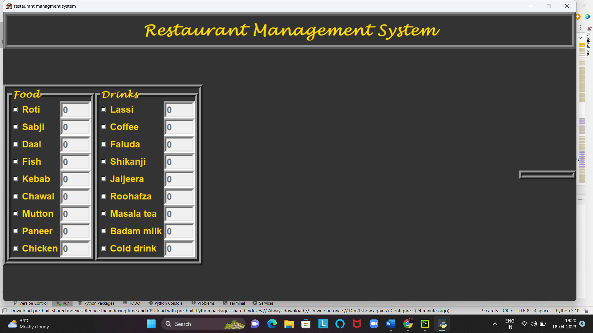

Slide 14
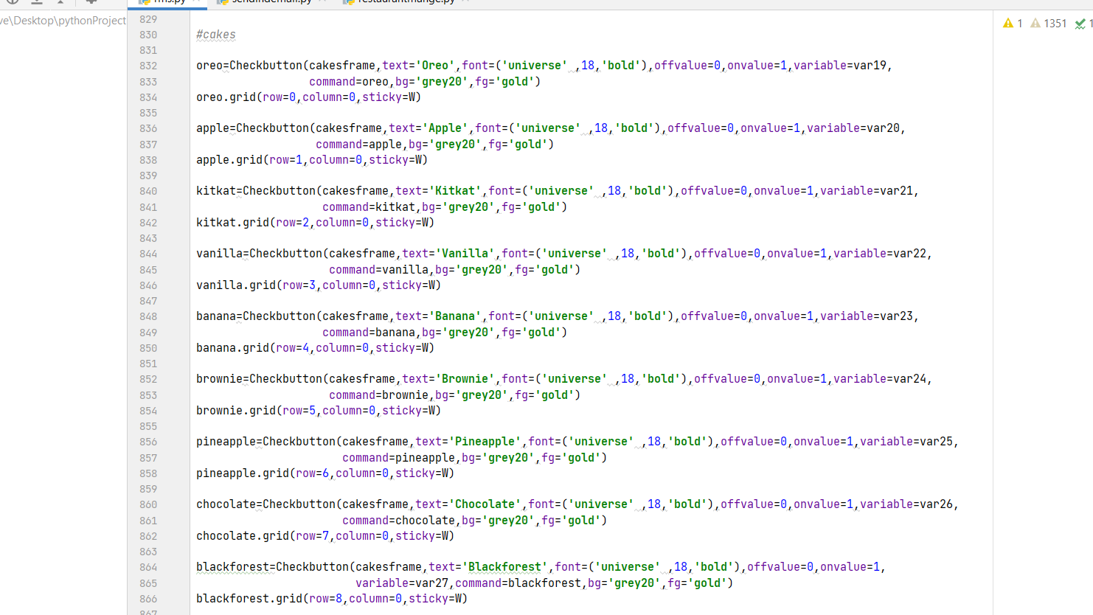
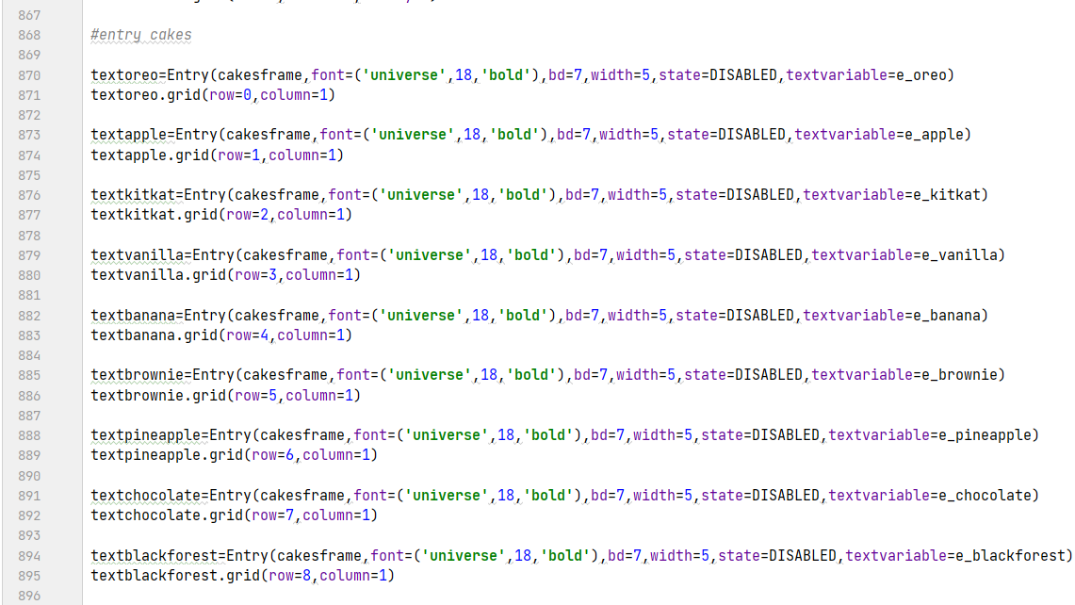
Create cakes frame

Slide 15
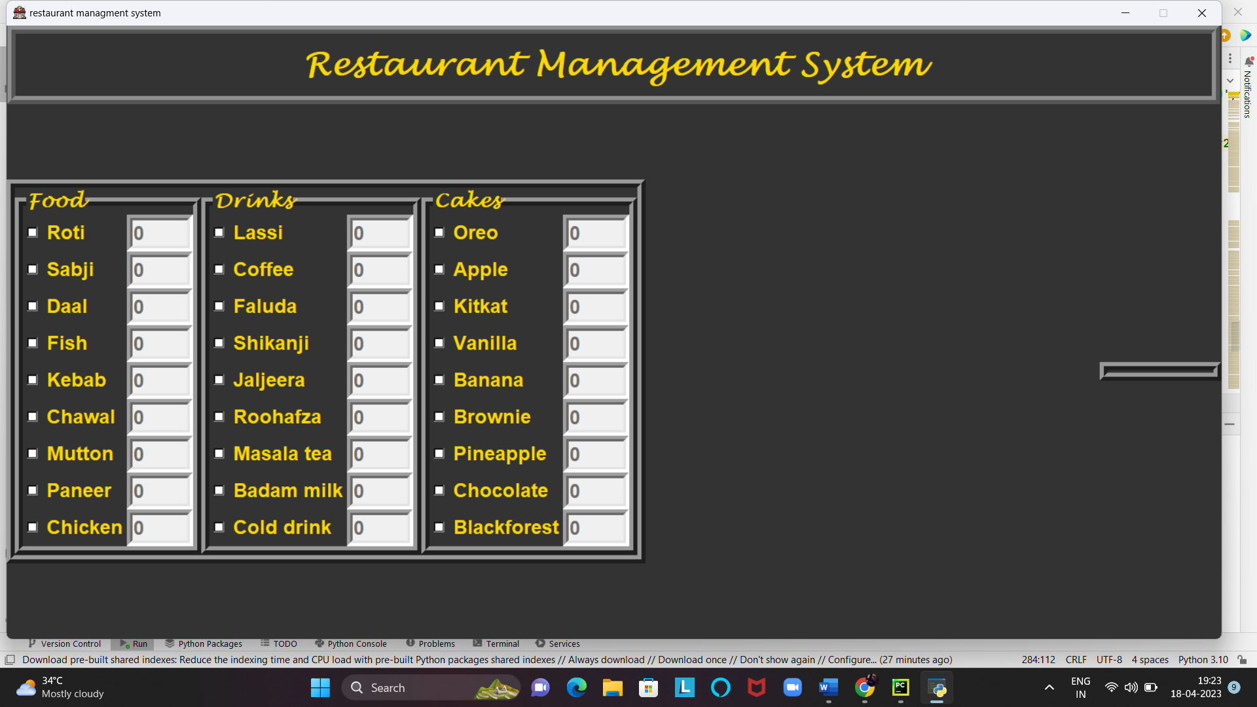

Slide 16
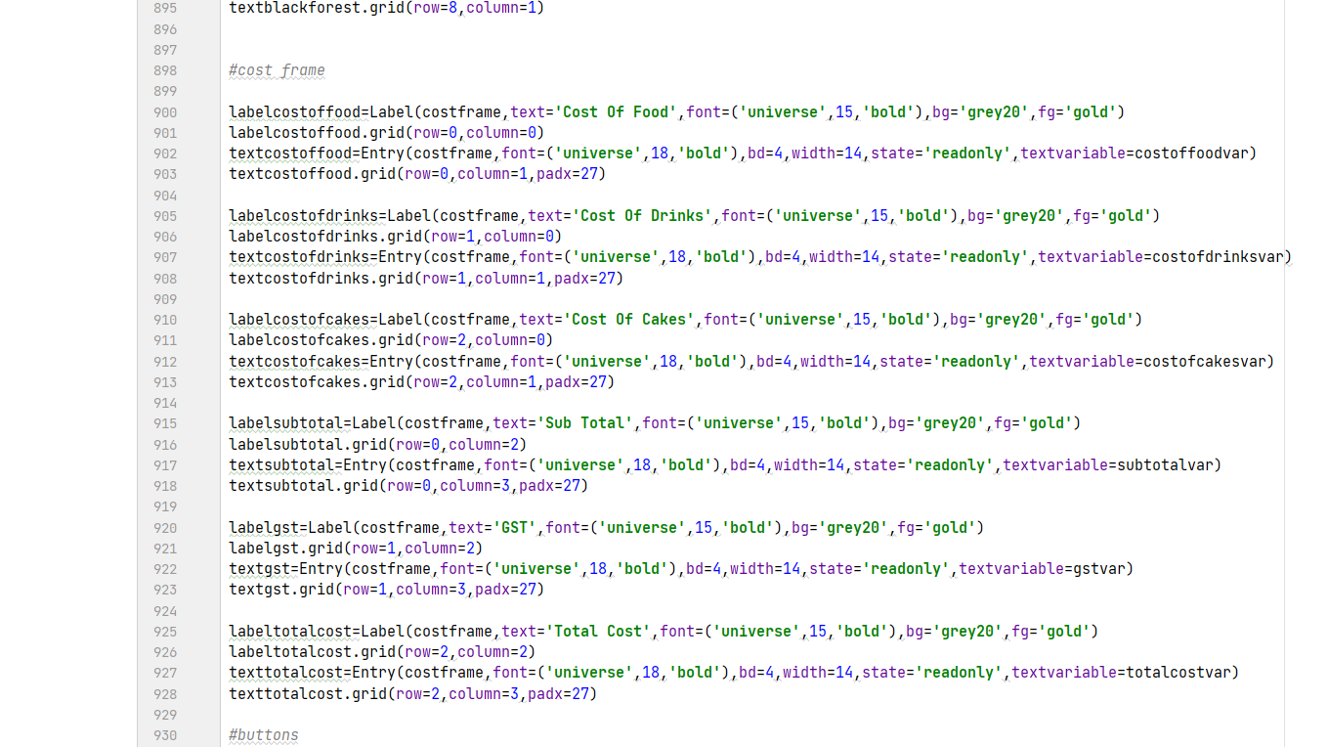
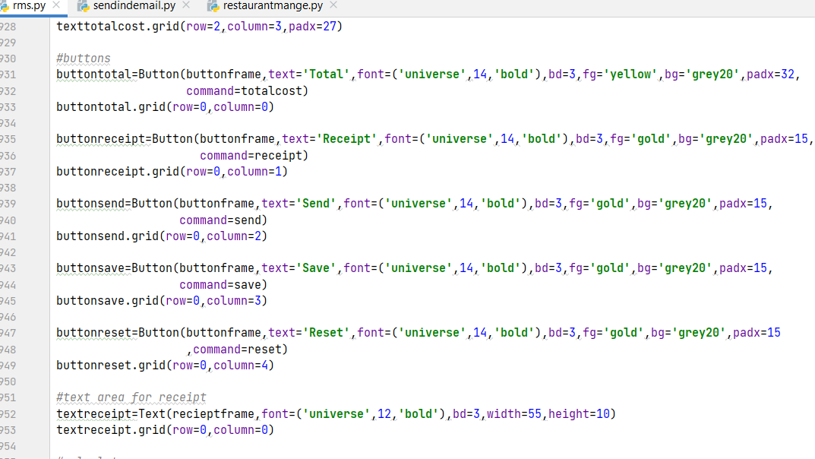
Create cost frame, create Buttons, Add text area for receipt

Slide 17
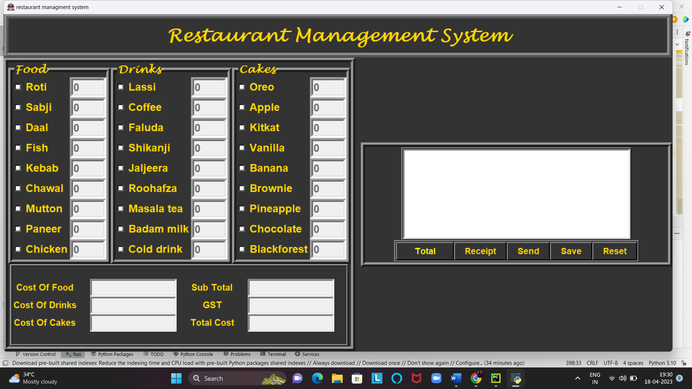

Slide 18
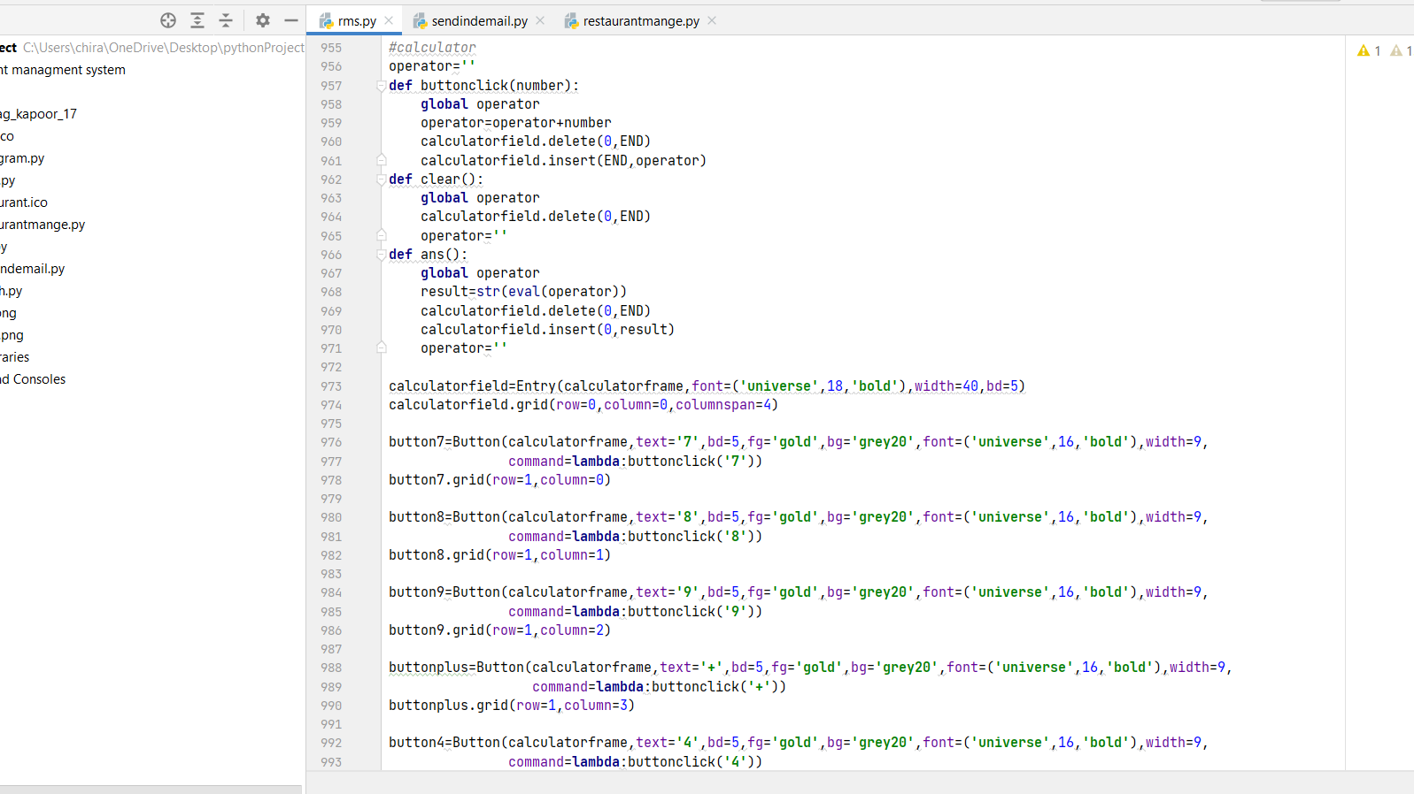
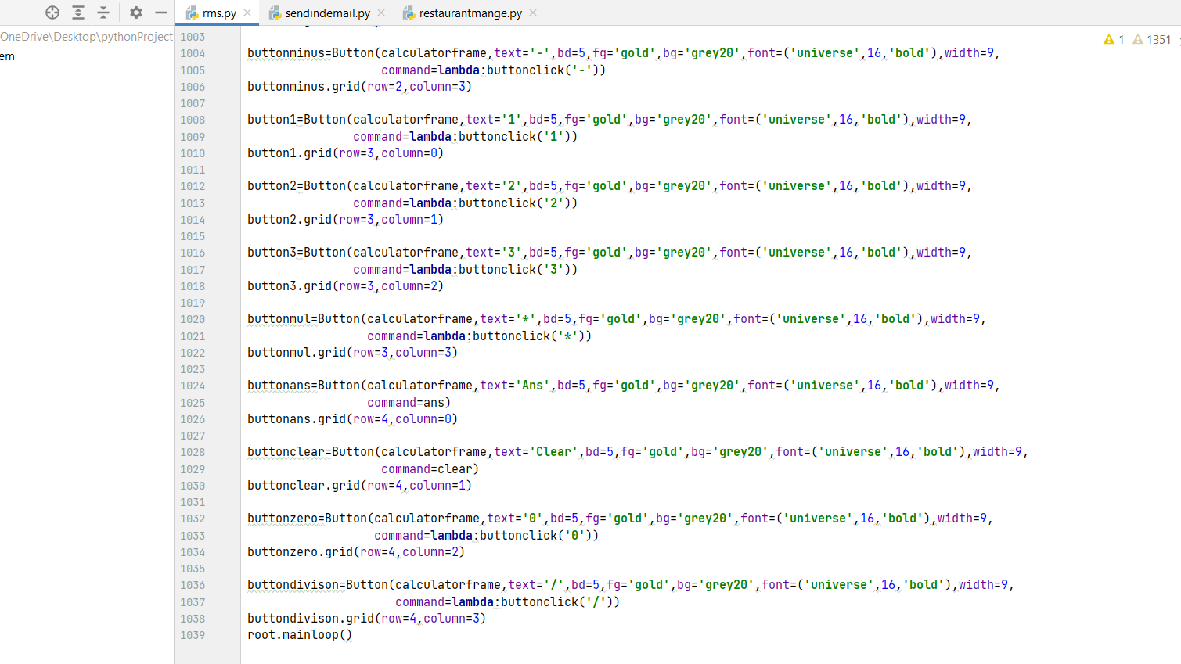
Now we create calculator

Slide 19
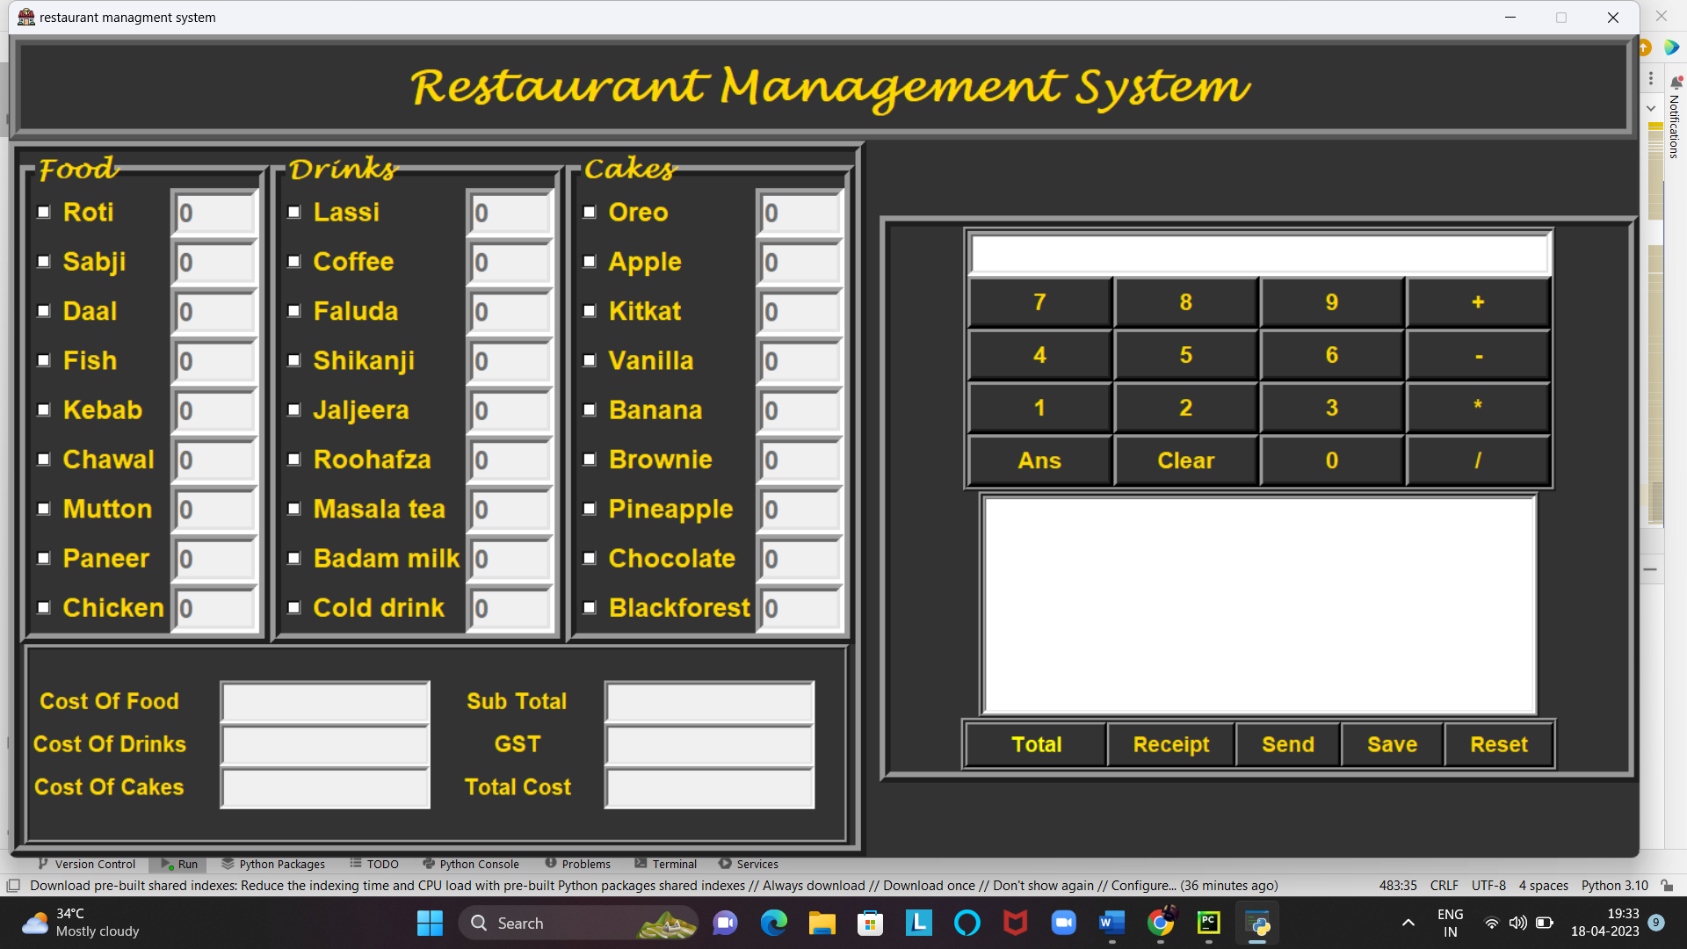

Slide 20
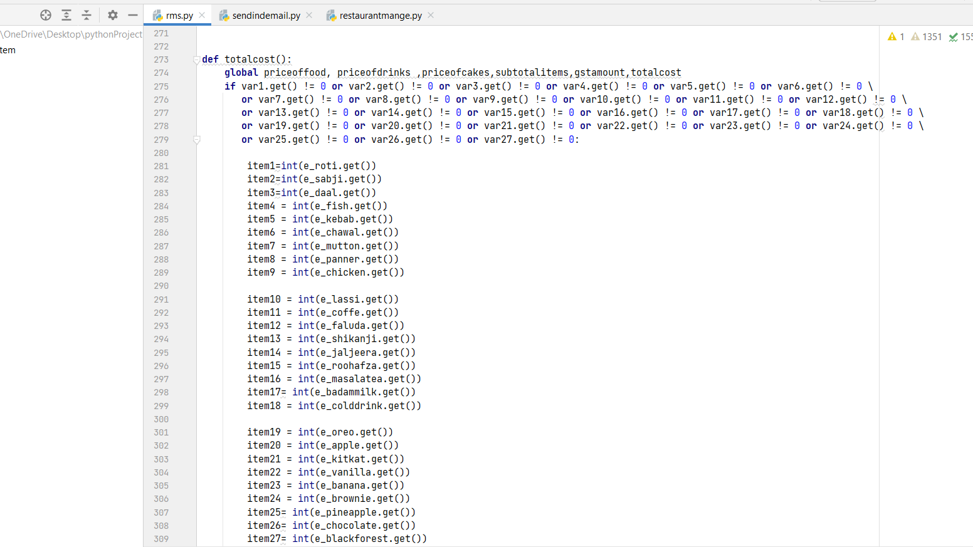
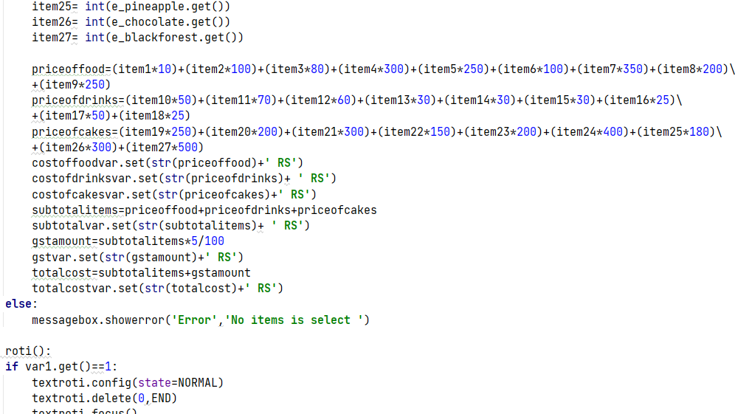
Defining the Total button function

Slide 21
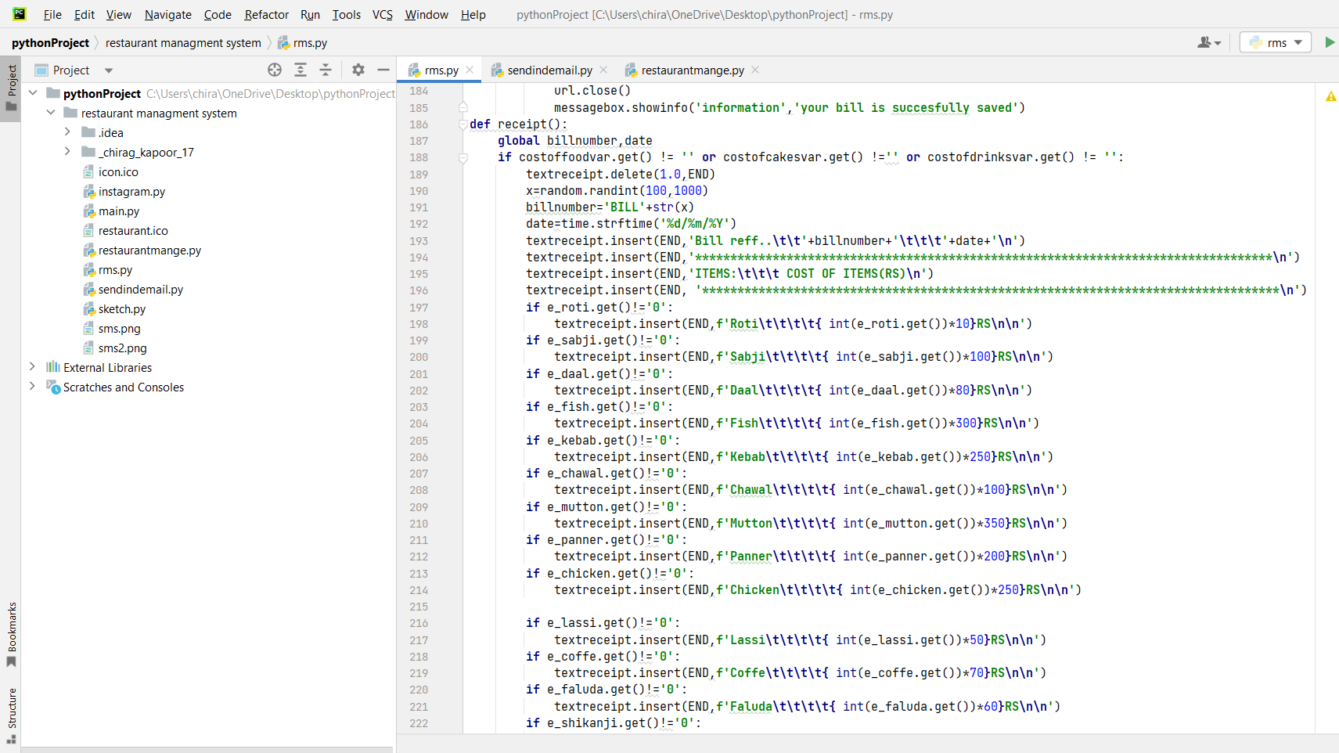
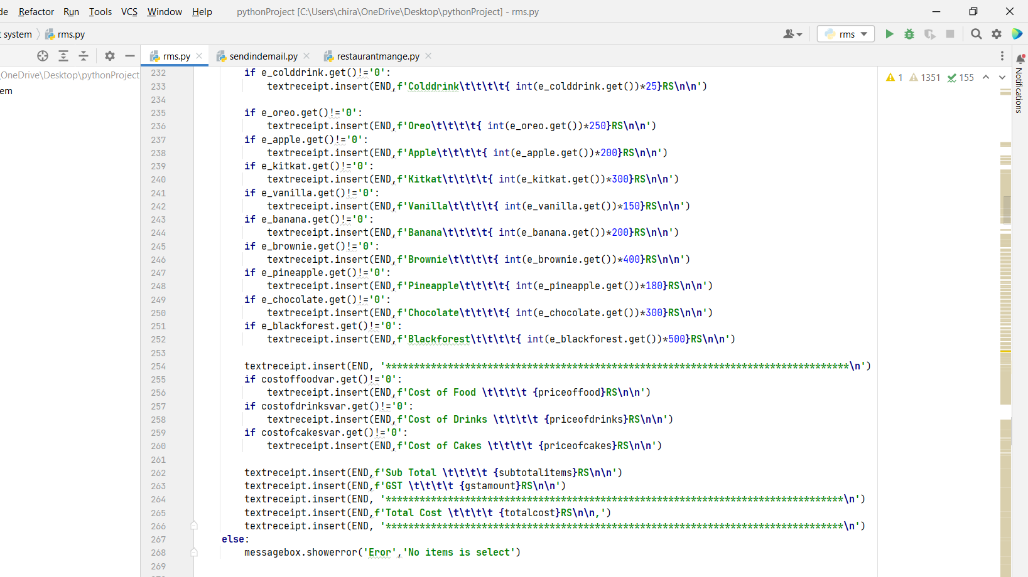
Defining the Receipt button function

Slide 22
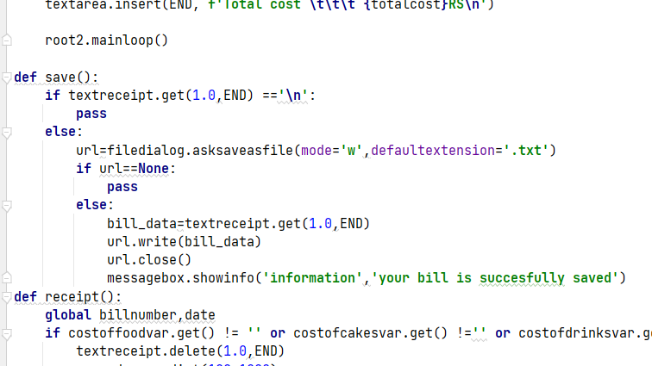
Defining the Save button functions

Slide 23
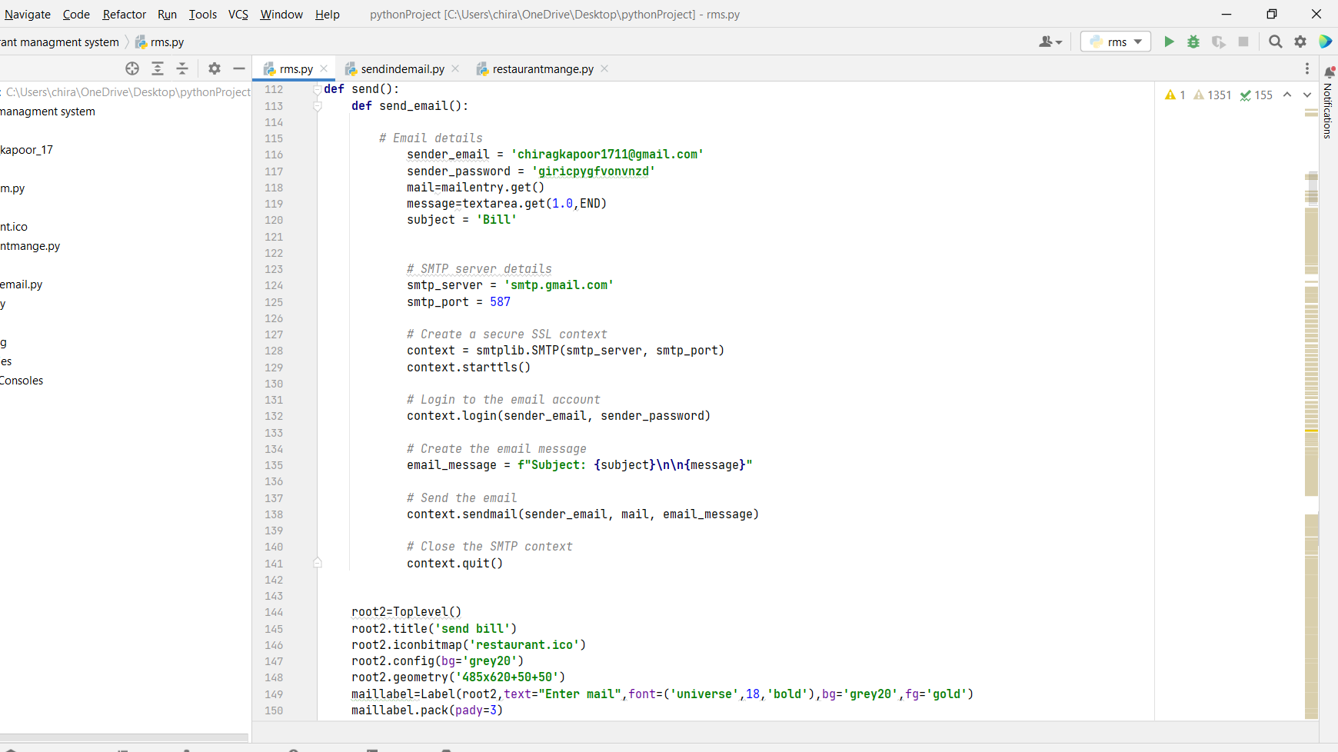
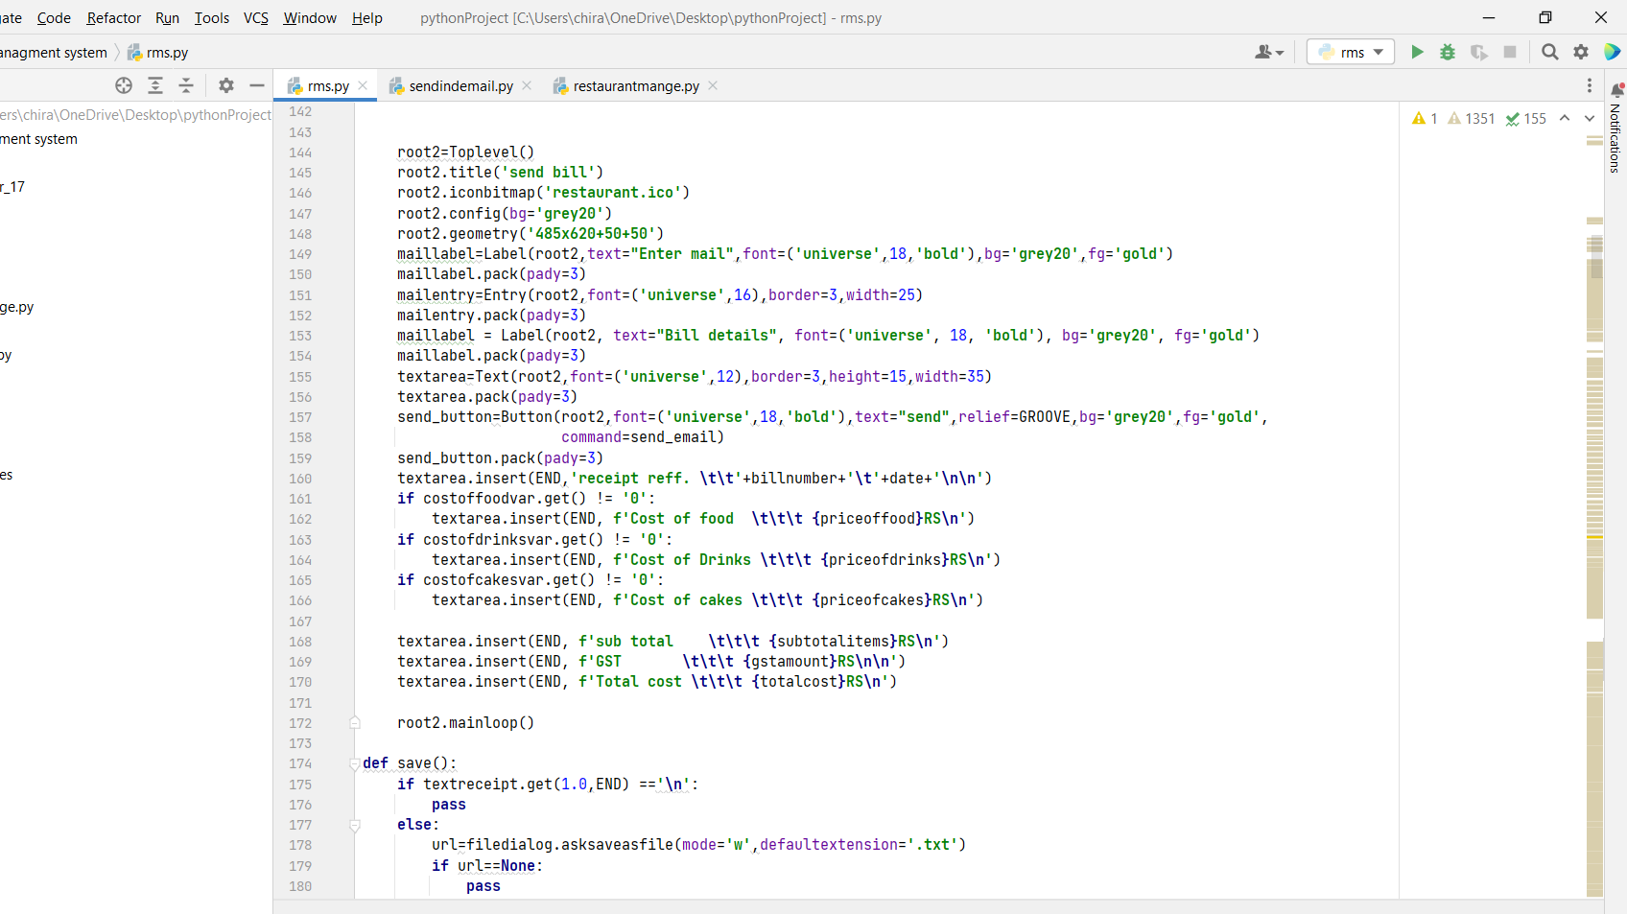
Defining the Send button function

Slide 24
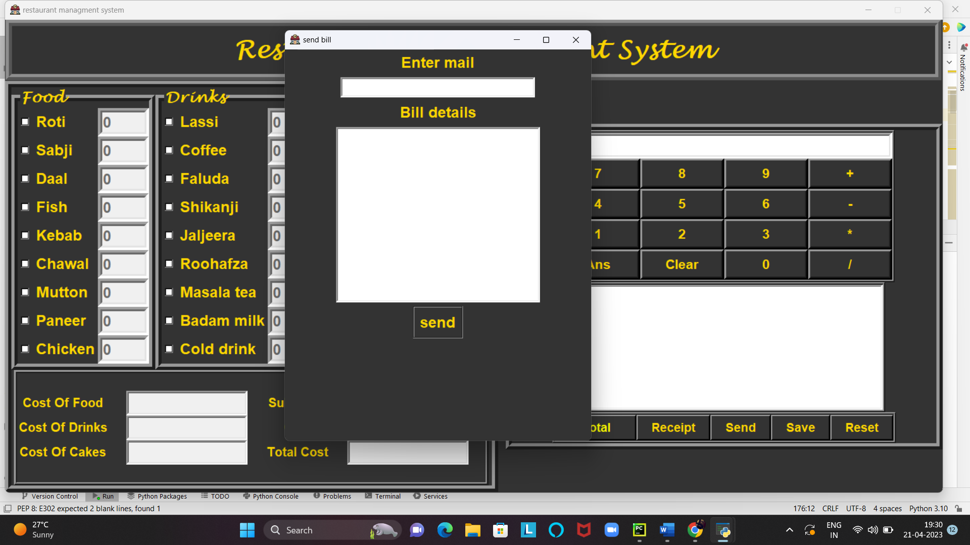

Slide 25
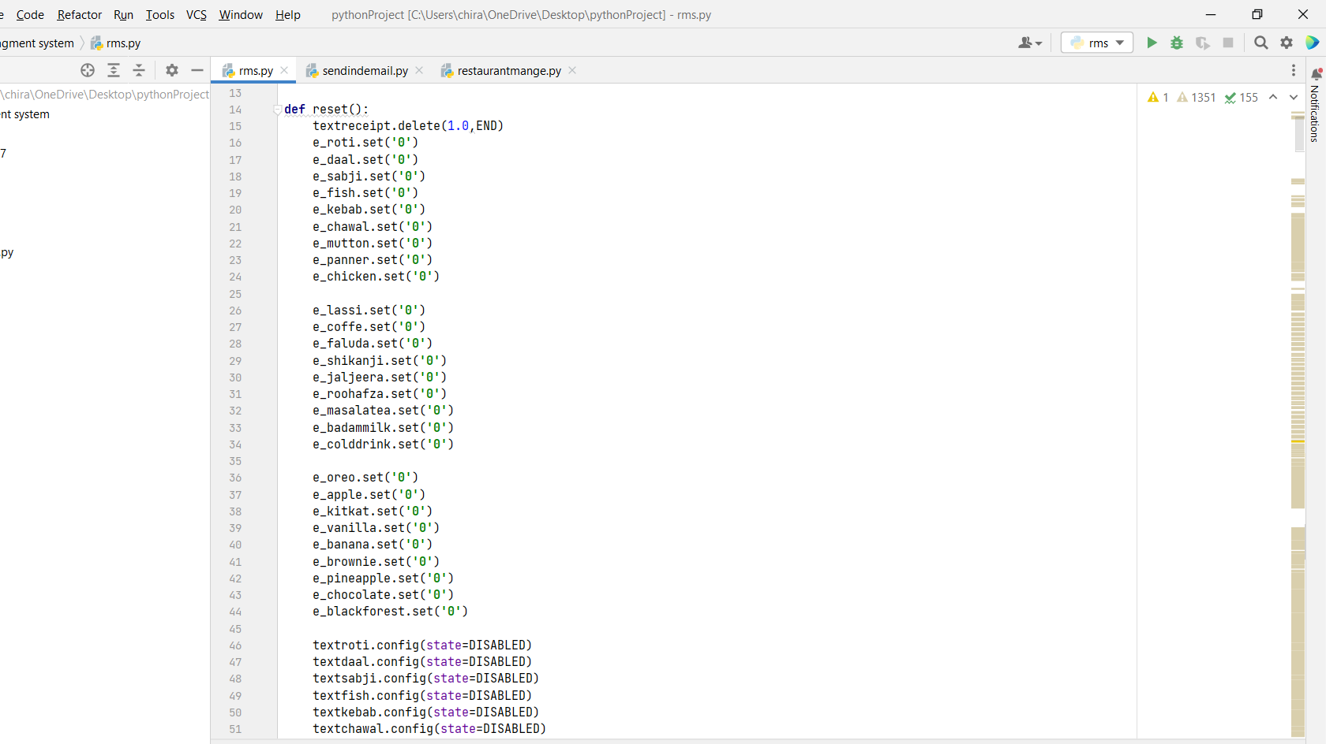
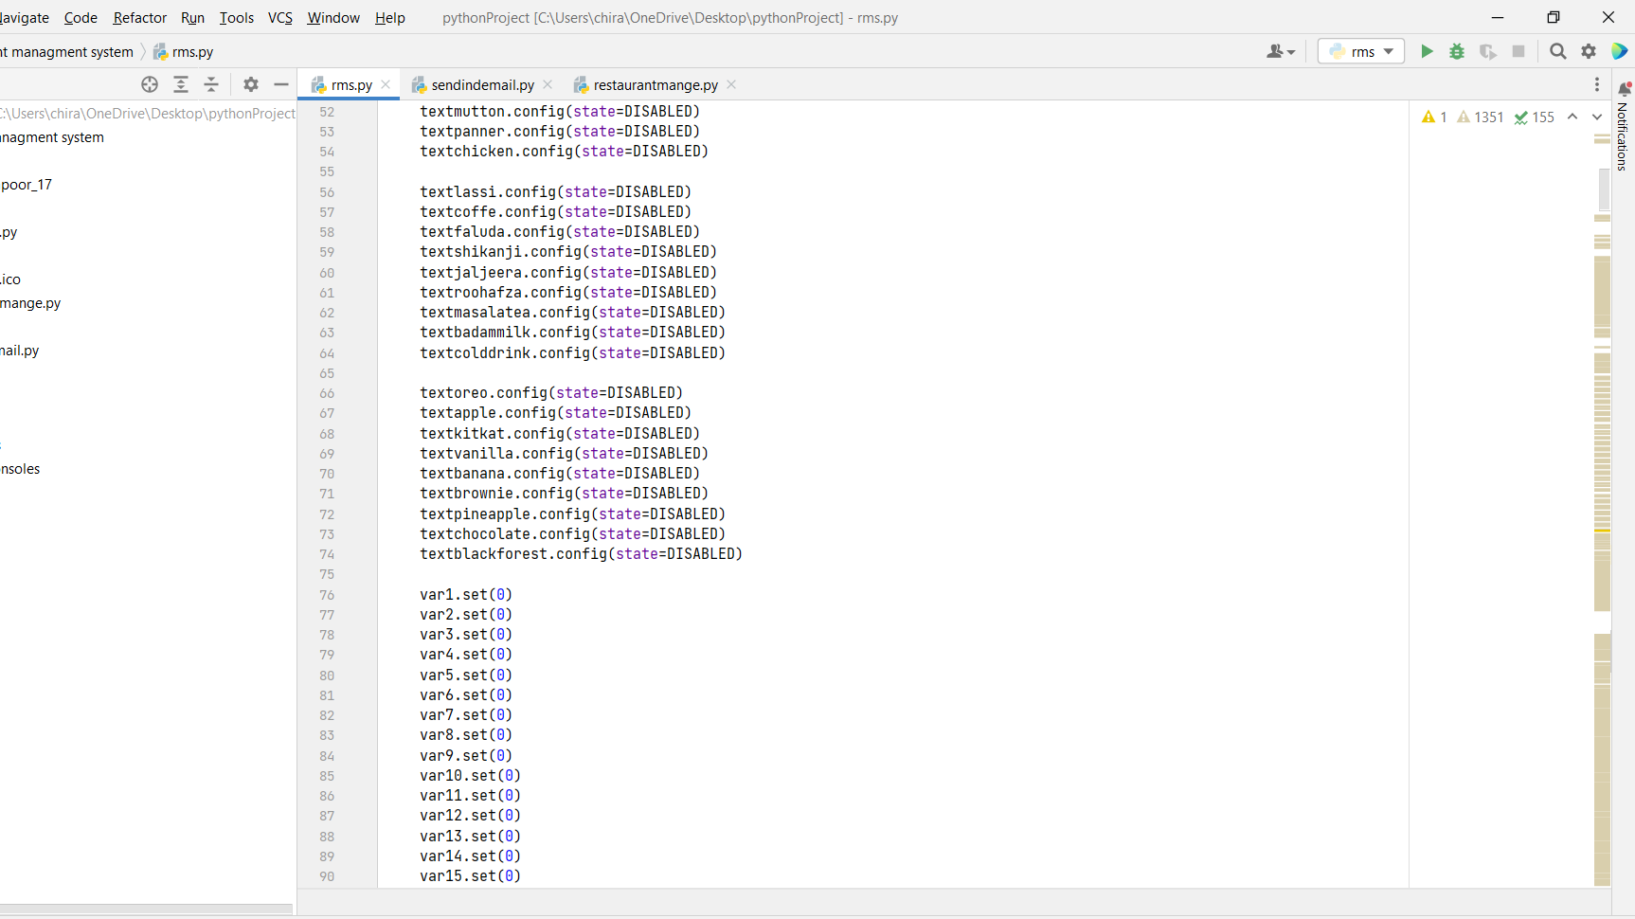
Defining the Reset button function

Slide 26
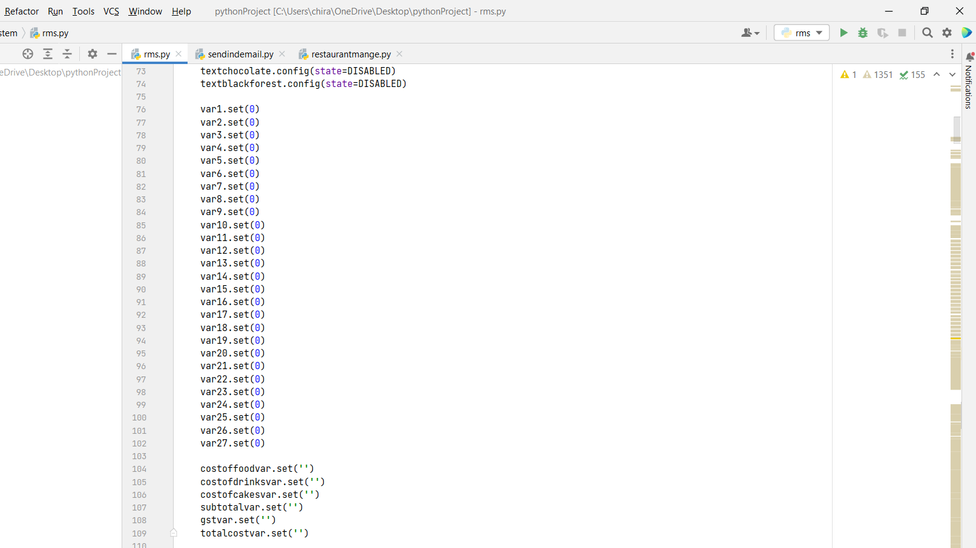

Slide 27
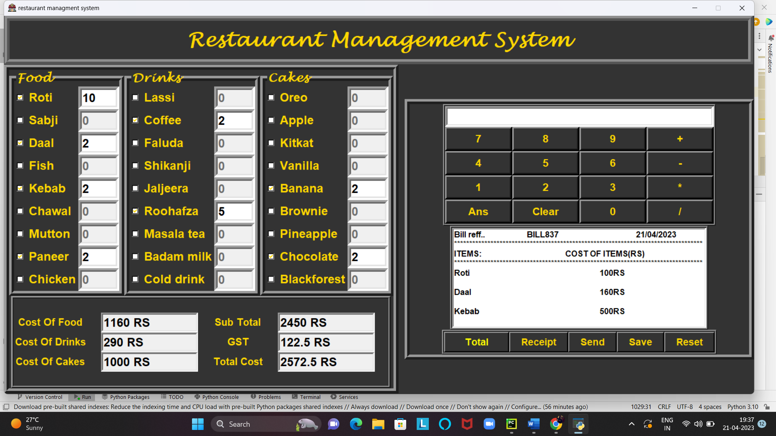
OUTPUT

Slide 28
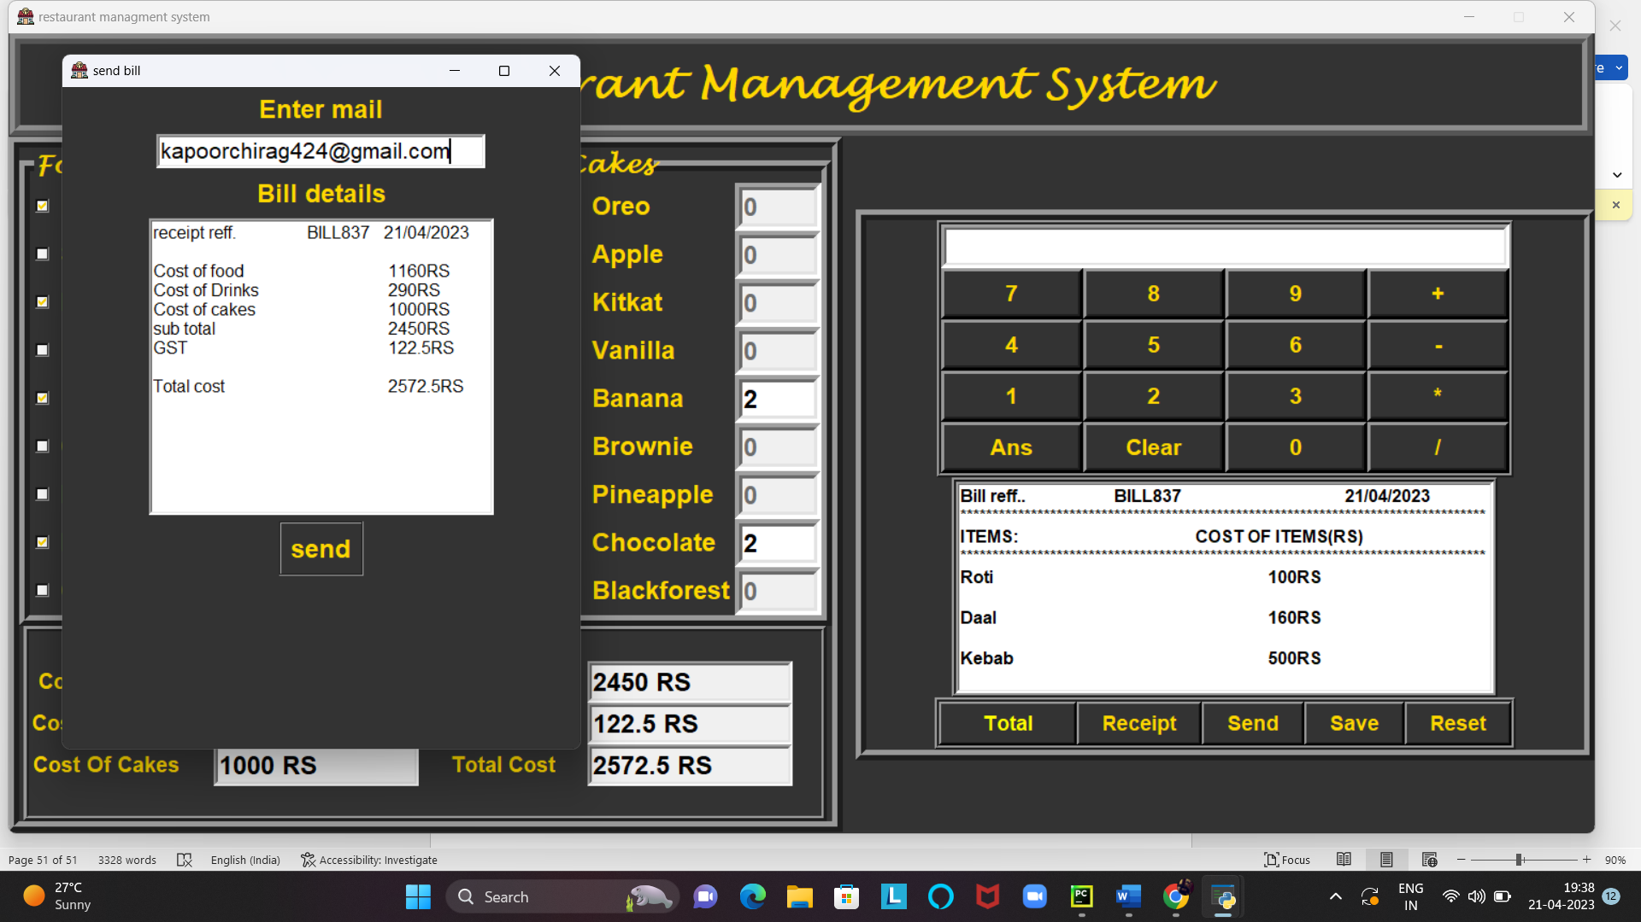
Then we send the bill to email

Slide 29
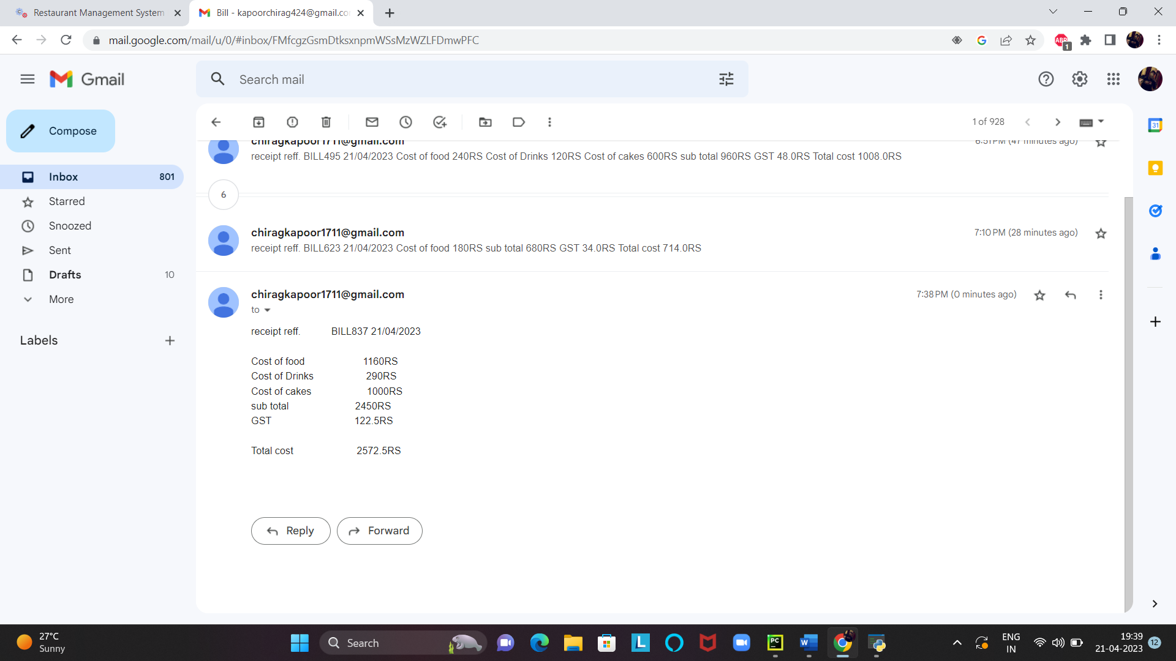
Got the bill on email

